Slide 1

Data Society: datasociety.co

Slide 2

Data Society Courses: datasociety.co
rCharts
Shiny
Web scraping
Networks
Maps
*
*
Data mining
K-means (Euclidean distance)
Sk-means (cosine distance)
*
*

Slide 3
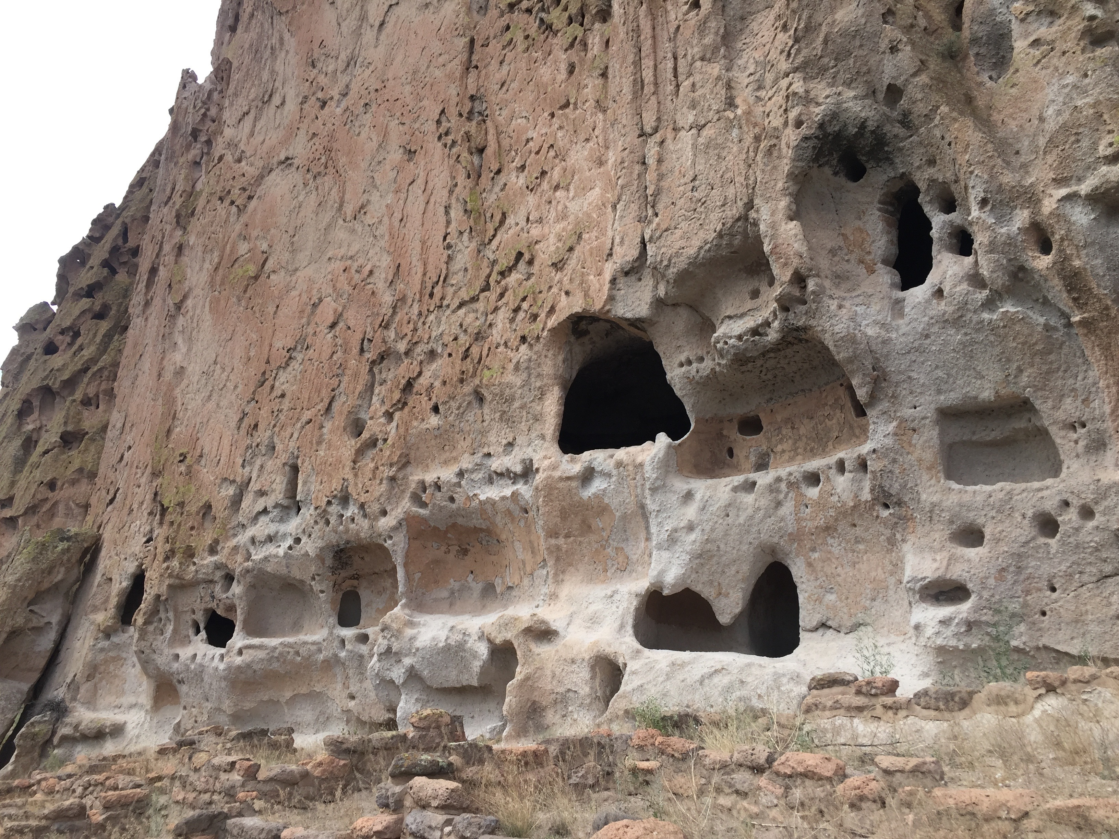
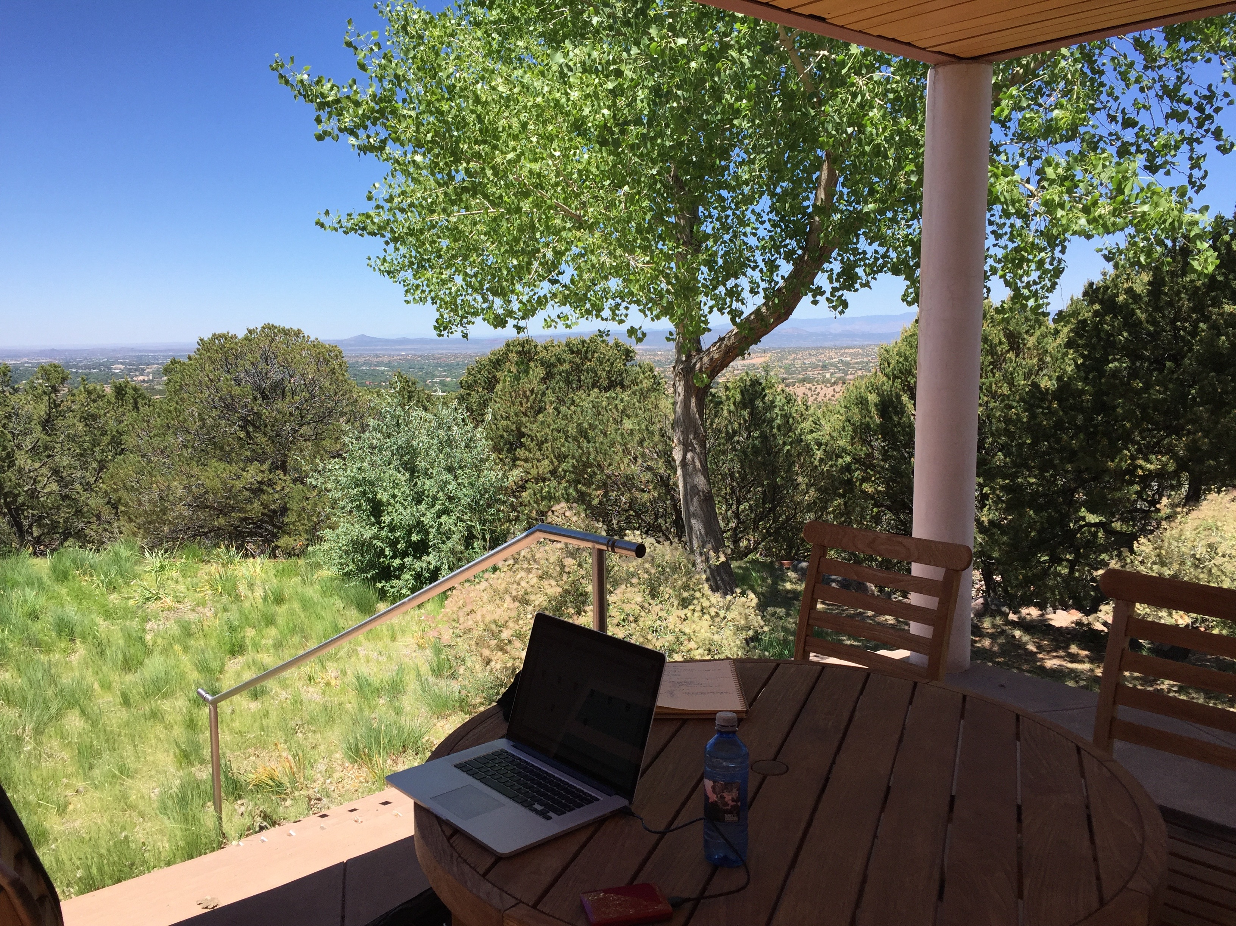
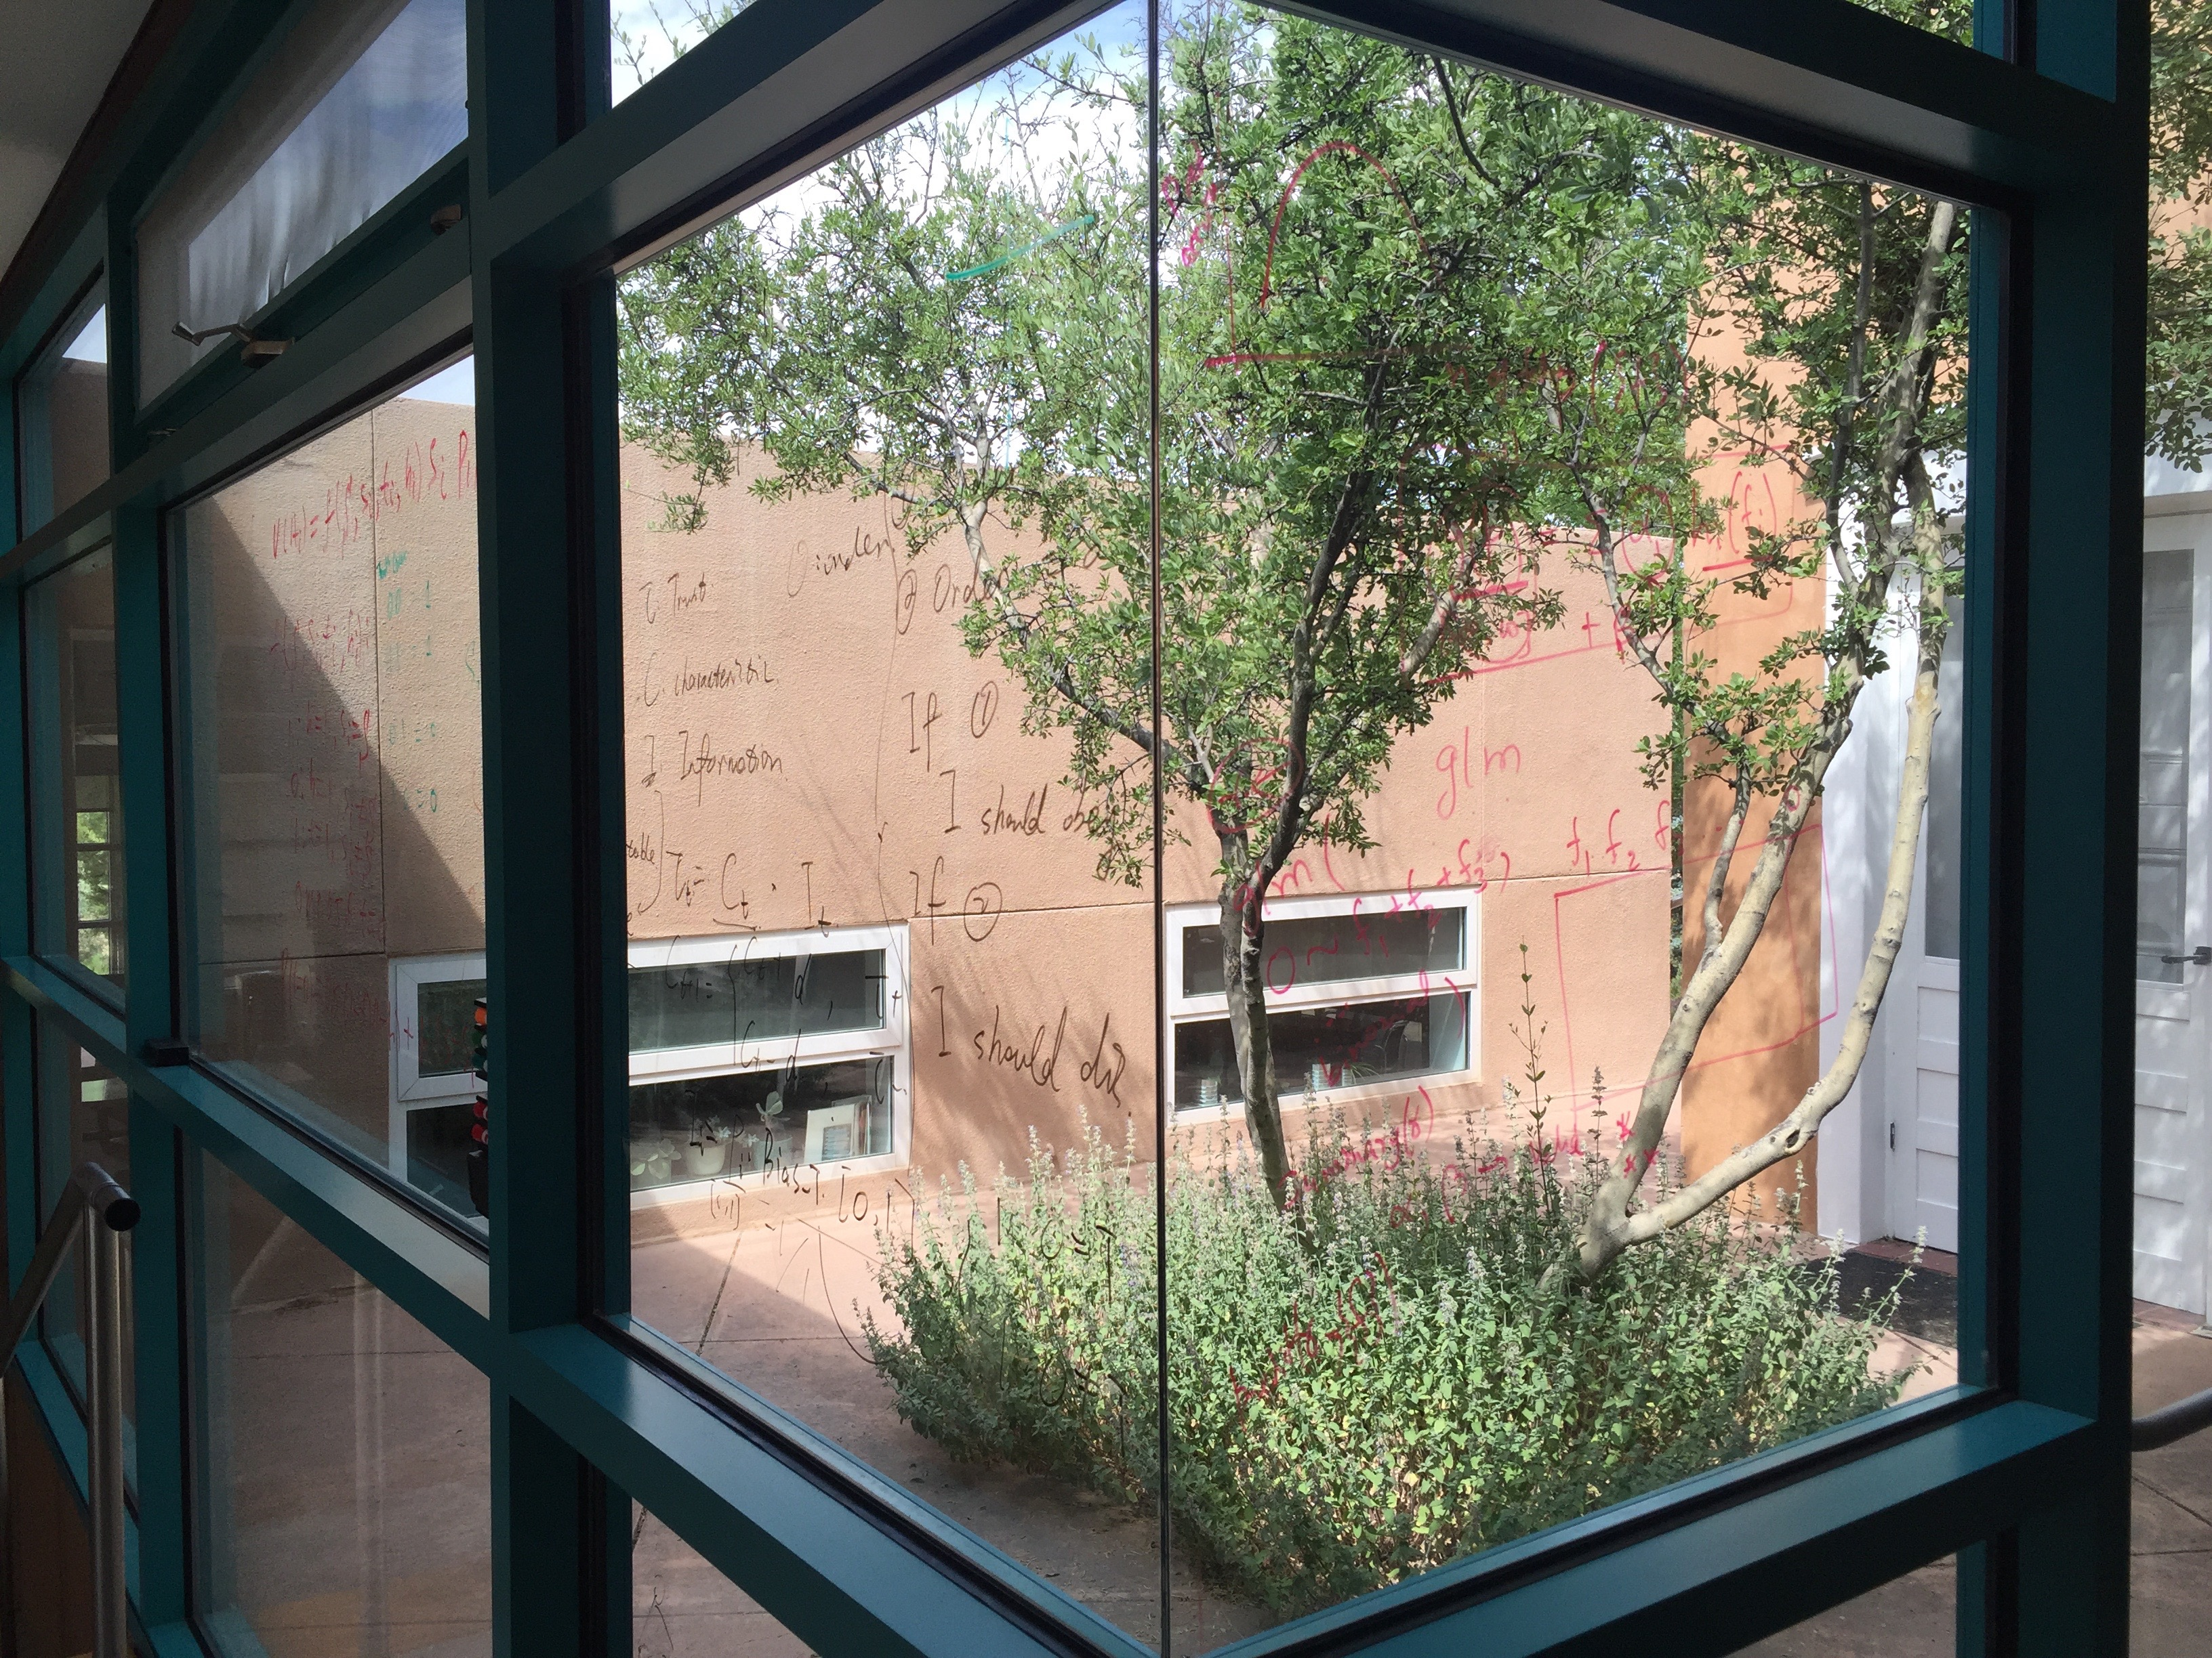
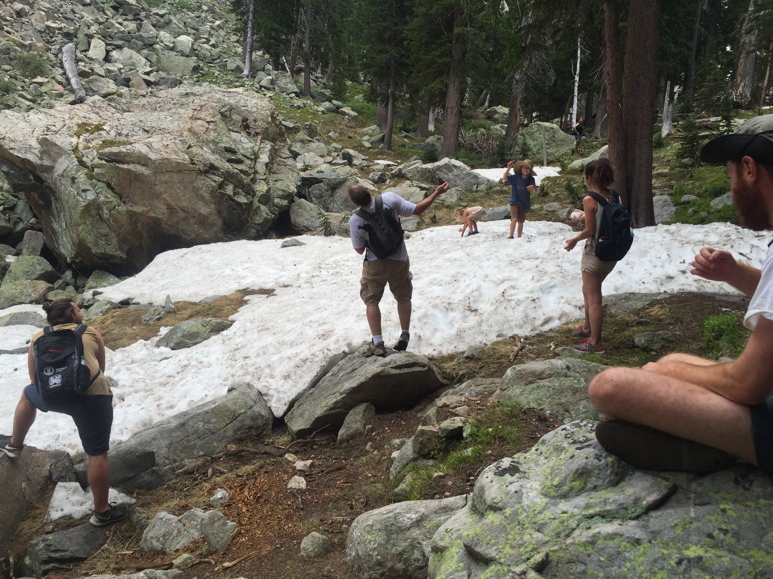
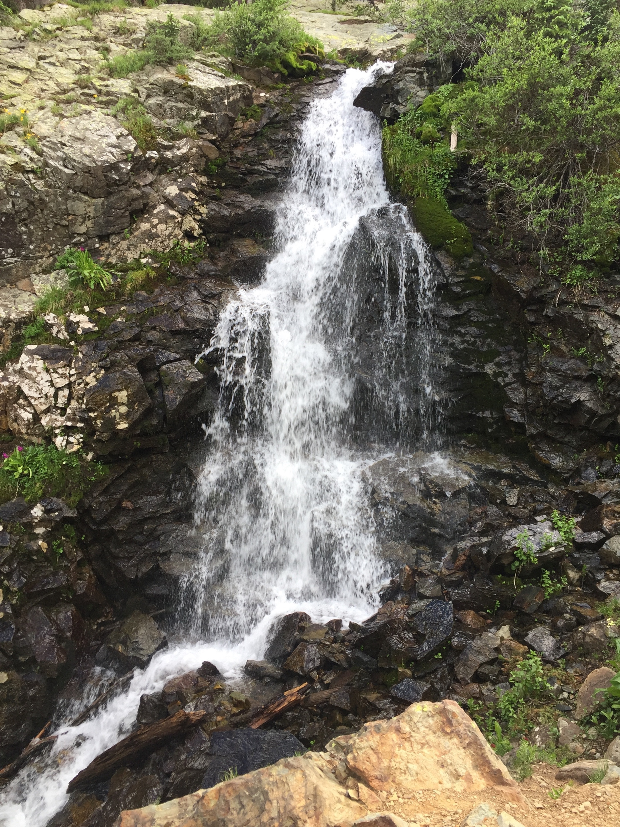
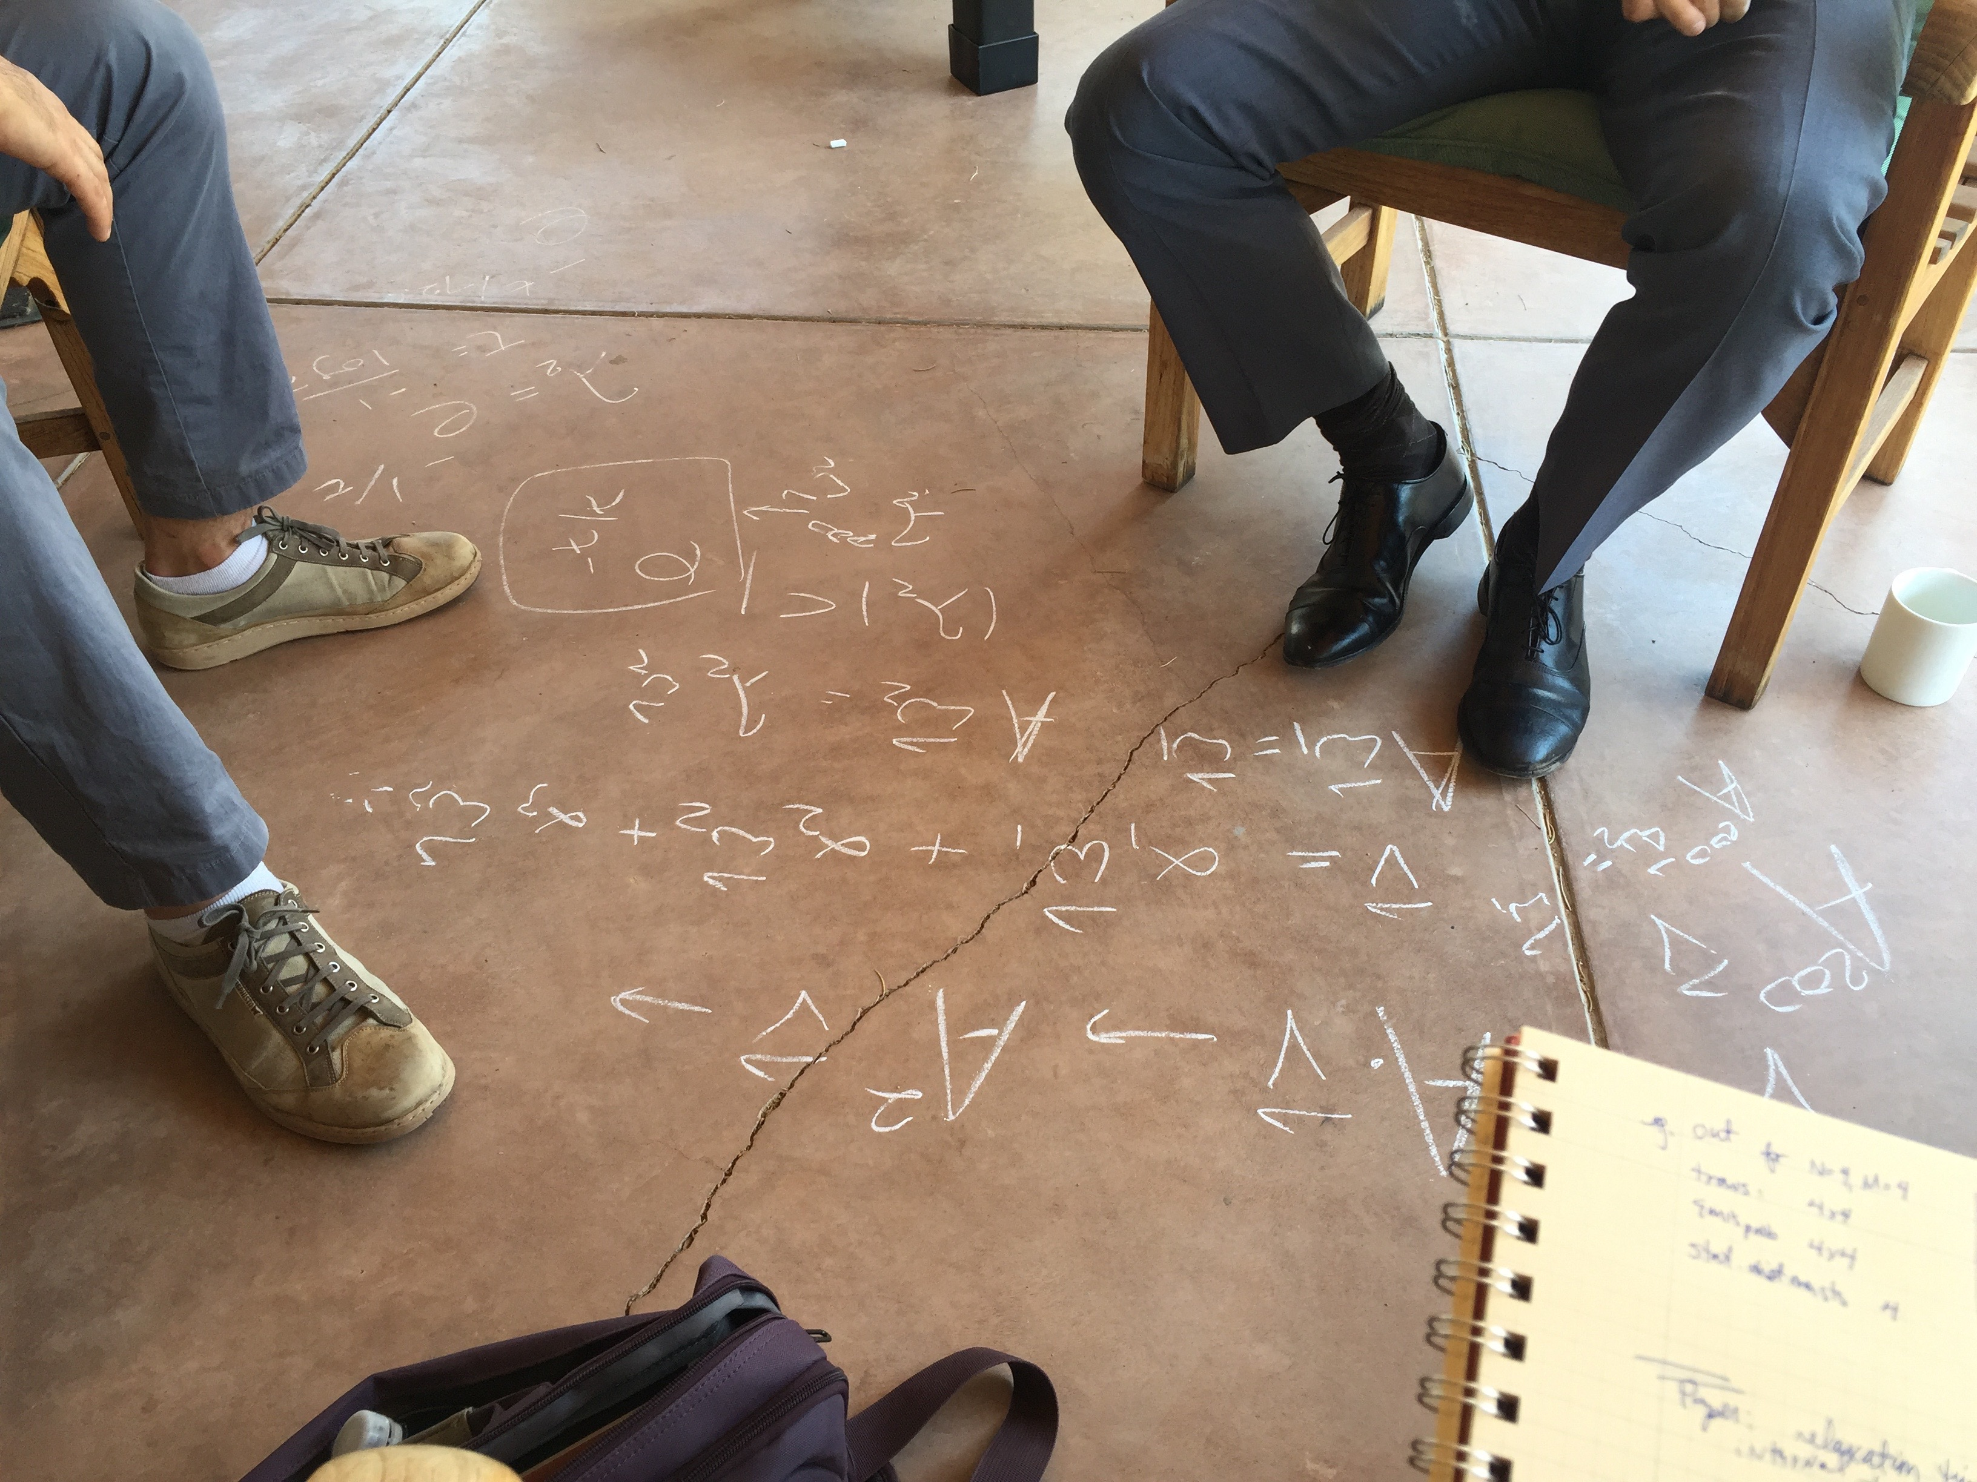

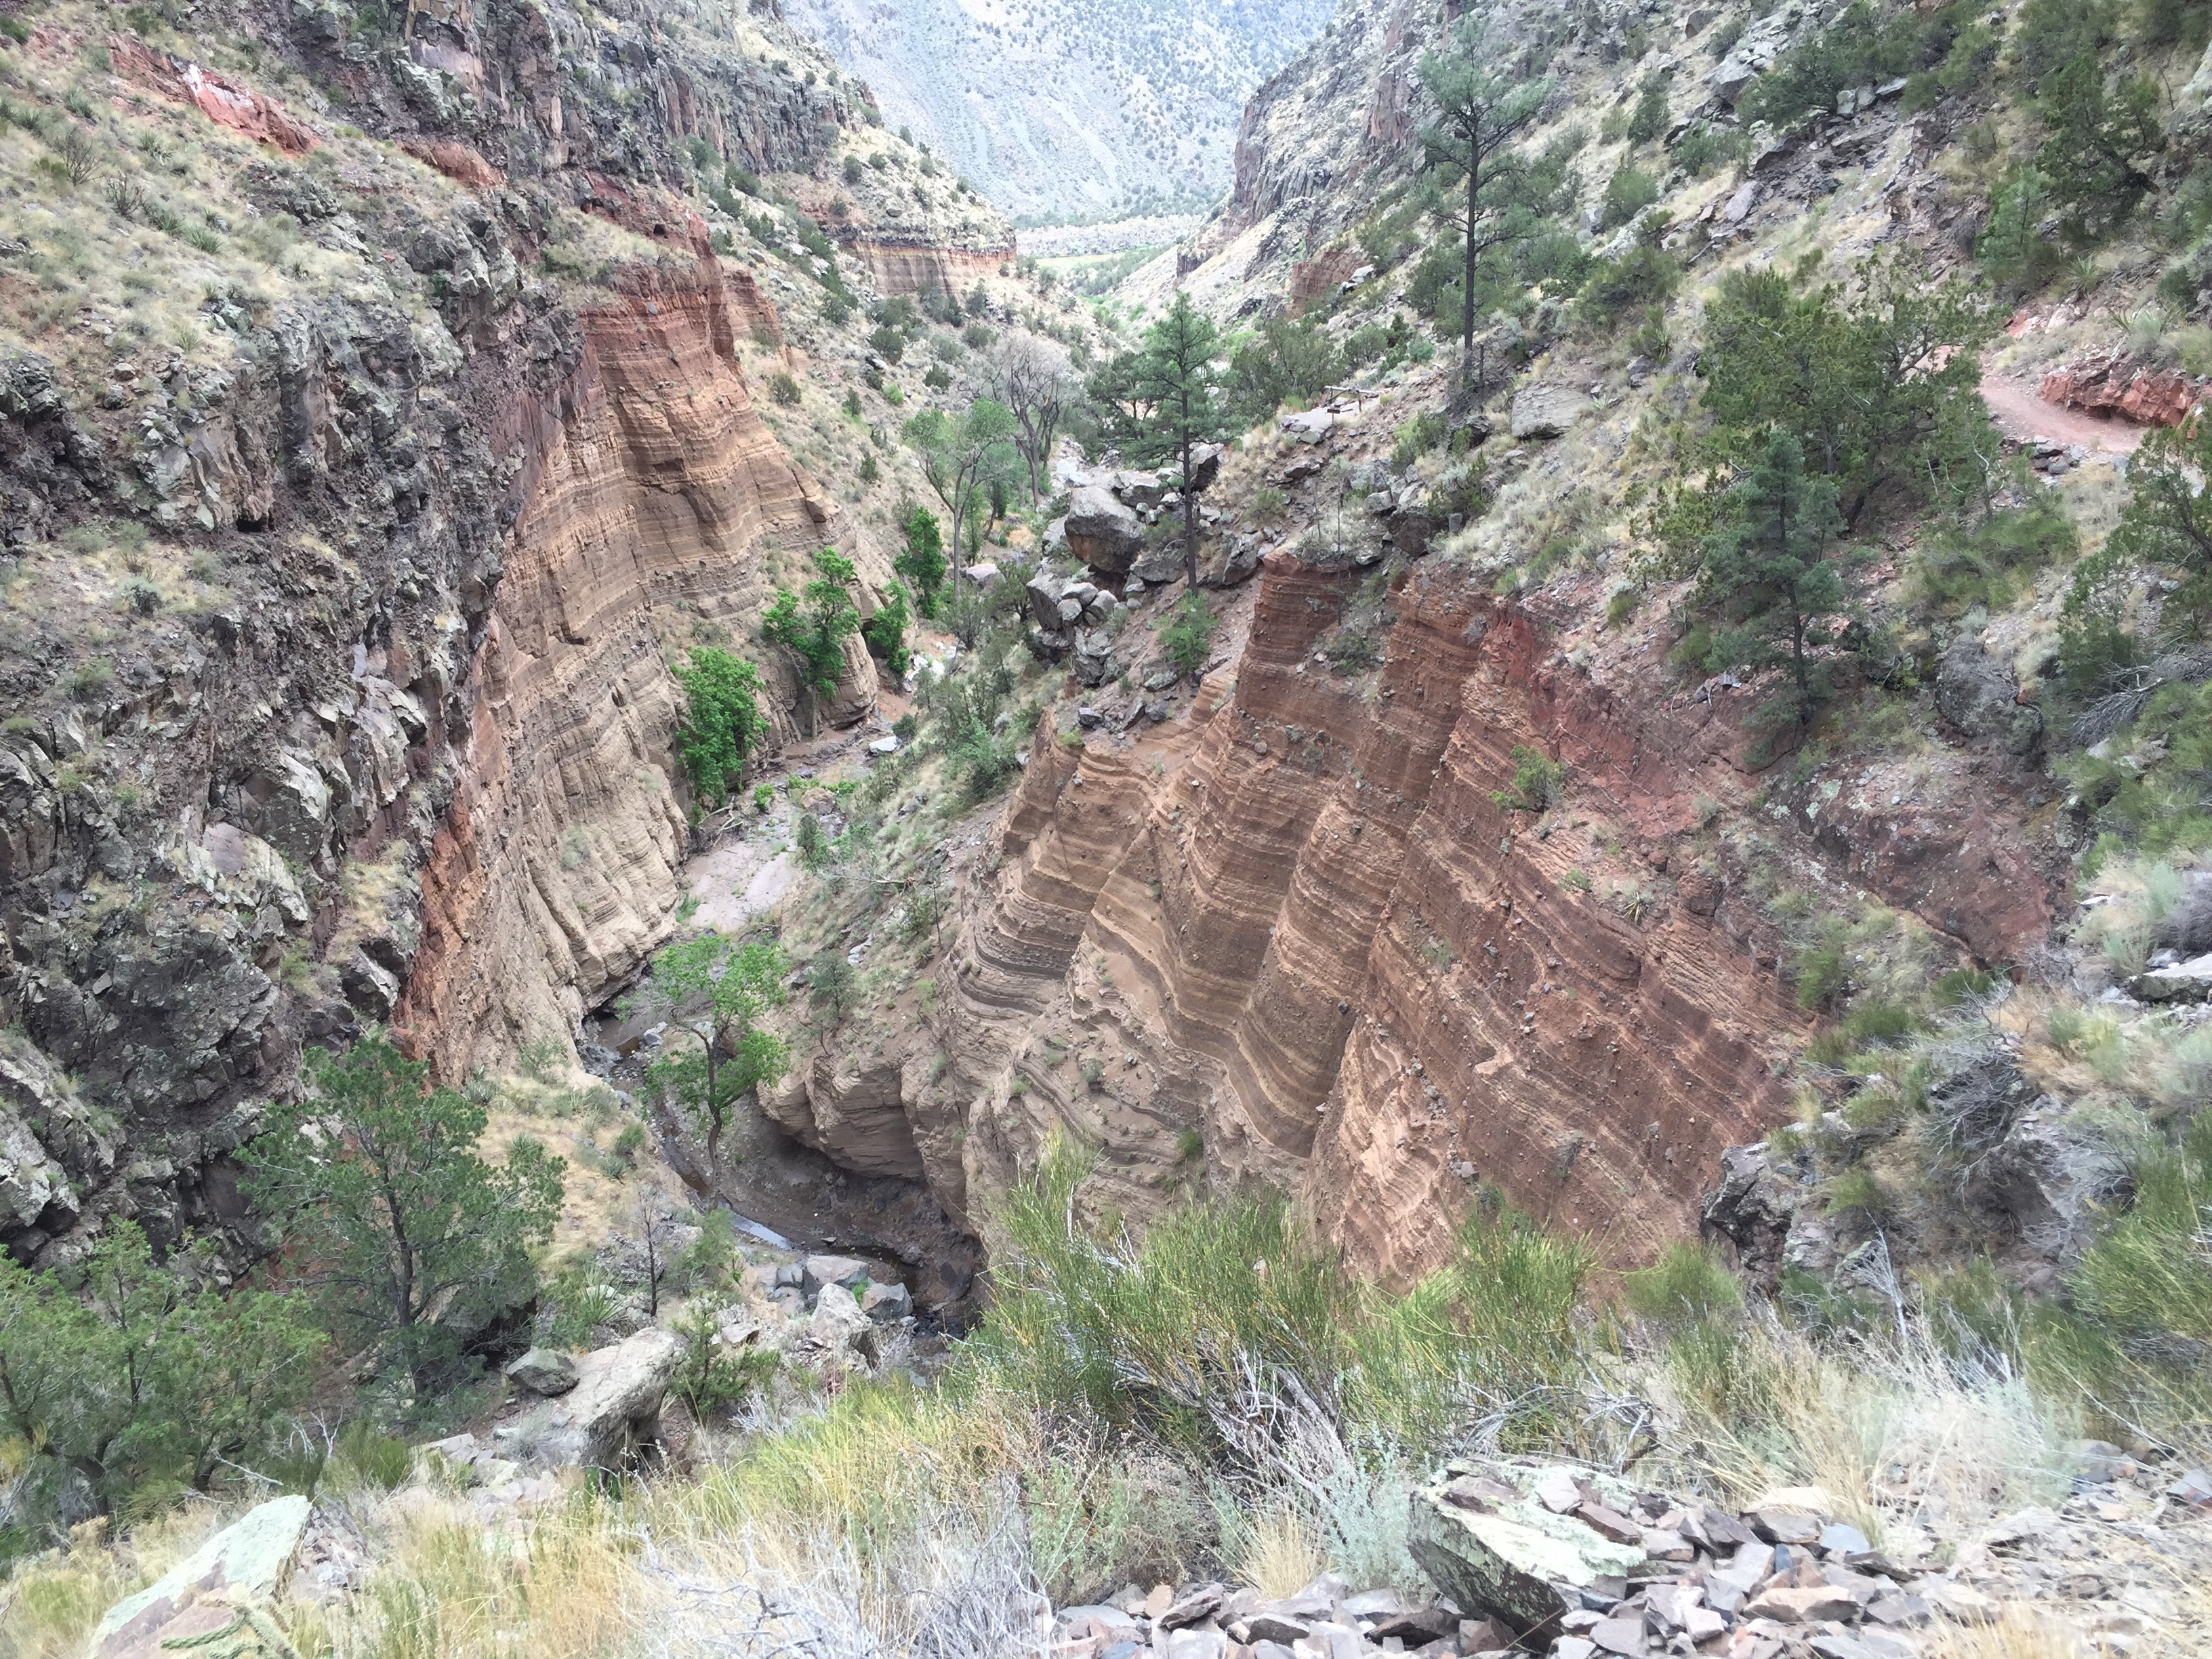

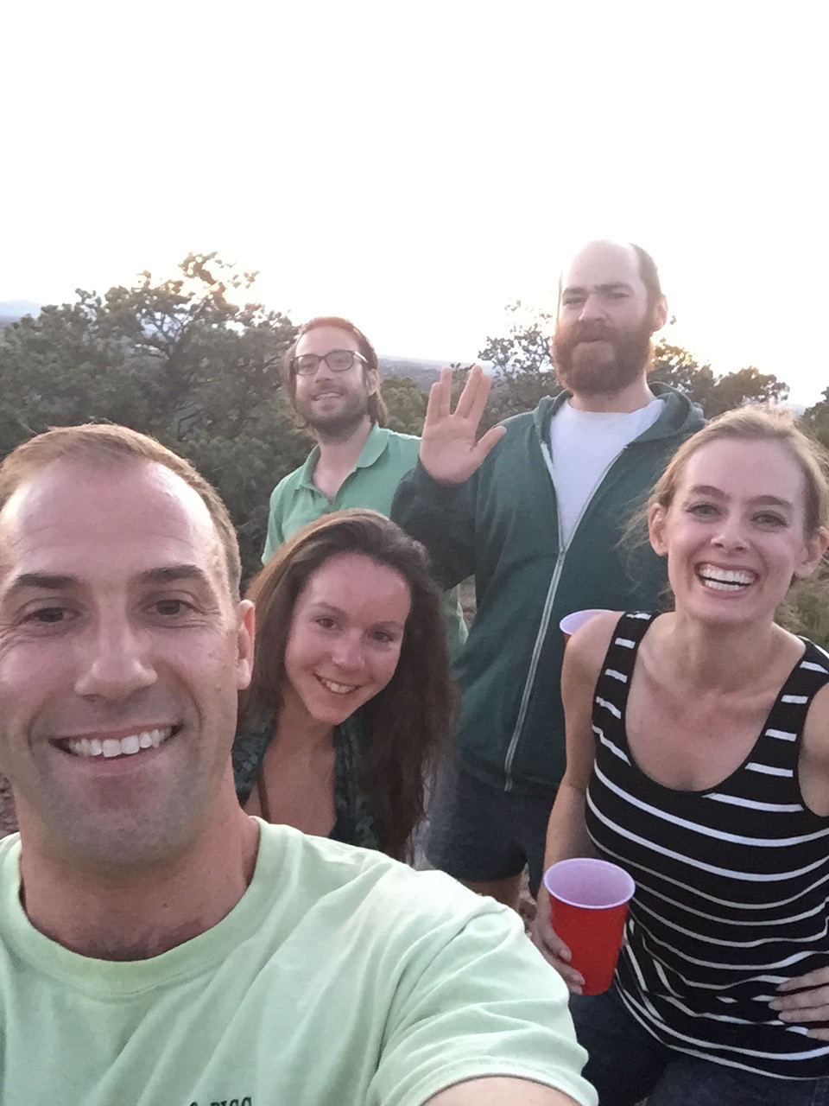
Santa Fe Institute

Slide 4

Co-evolution of strategic decision making: DOTA 2 as a proxy for cybersecurity environments
Anne Sallaska Santa Fe Institute Complex Systems Summer School
August 11, 2016

Slide 5
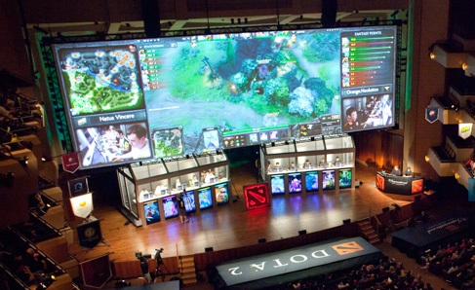

Overview
Cybersecurity motivation
DOTA 2 data as a test bed for models
Games as hidden Markov model
Relative player positions as observed states in a HMM

Slide 6

Cyber Intrusion Detection
Computer hackers use evolving strategies to penetrate systems
Intentionally hidden
Difficult to pinpoint observables that can be used to identify strategies
If strategies not clearly determined
Adapting defensive tactics to counteract in real time: problematic
Goals:
Detect strategies
Quantify the rate of change of strategies in co-evolutionary systems

Slide 7


Data is Scarce
Real intrusion data is scarce
Use video game data as a proxy
Experiment with different methods to extract underlying strategies
Not important: strategy’s details
Important: ability to confirm some strategy exists
Port general framework to cyber
Other co-evolutionary domains:
USDA facilities: correlate observables to food-related outbreaks
Stock market: model transactions to identify strategies/change points

Slide 8
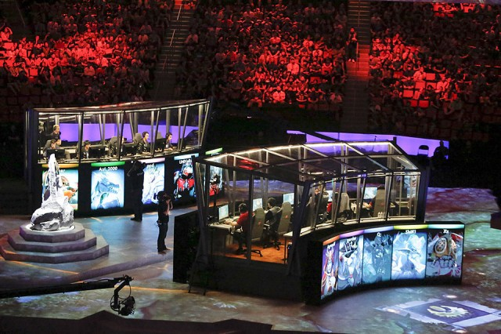
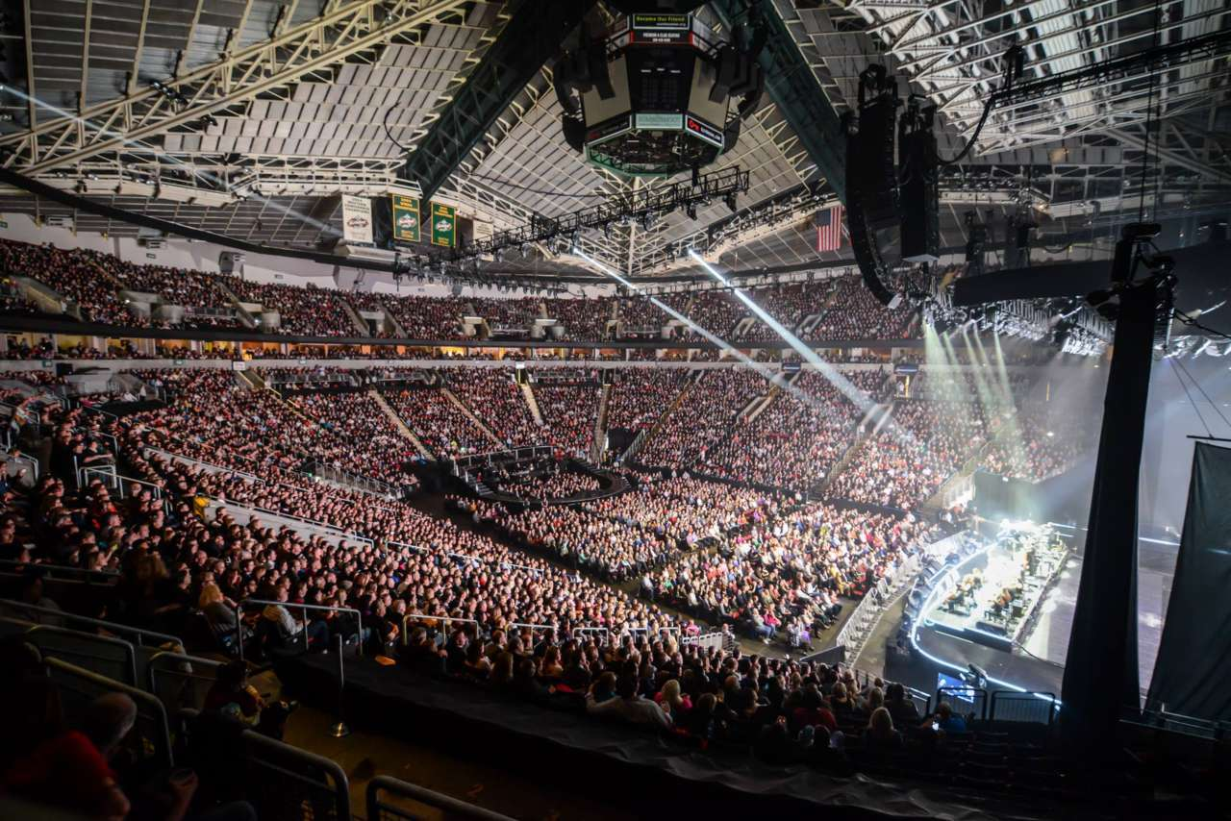
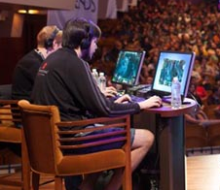
DOTA 2: Defense of the Ancients
Competitive strategy game
5 players vs 5 players
Games: ~ 20 – 90 minutes
Over 2 billion games played
Professional or amateur
Prize money: ~$17 M
Access to aggregate, raw game data

Slide 9
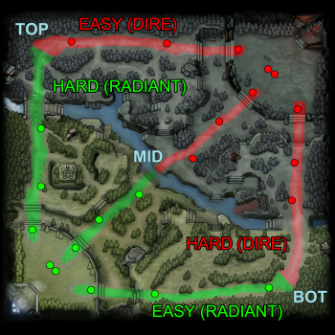



Gameplay
Goal: destroy other team’s base
Each player controls “hero” character
~120 available heroes
Abilities: intelligence, strength, agility
Professional games include a draft
Each team can pick and ban heroes
Game makers issue patches to rebalance game, disrupting strategies

Slide 10
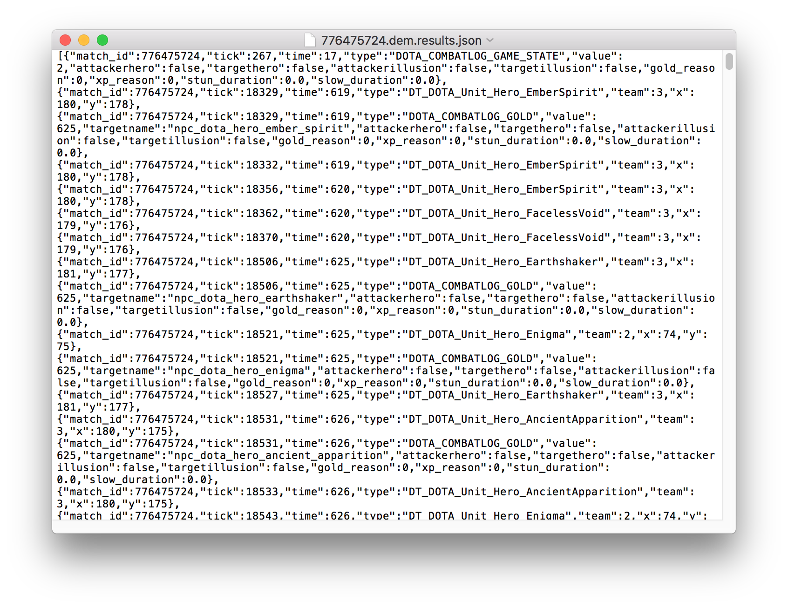
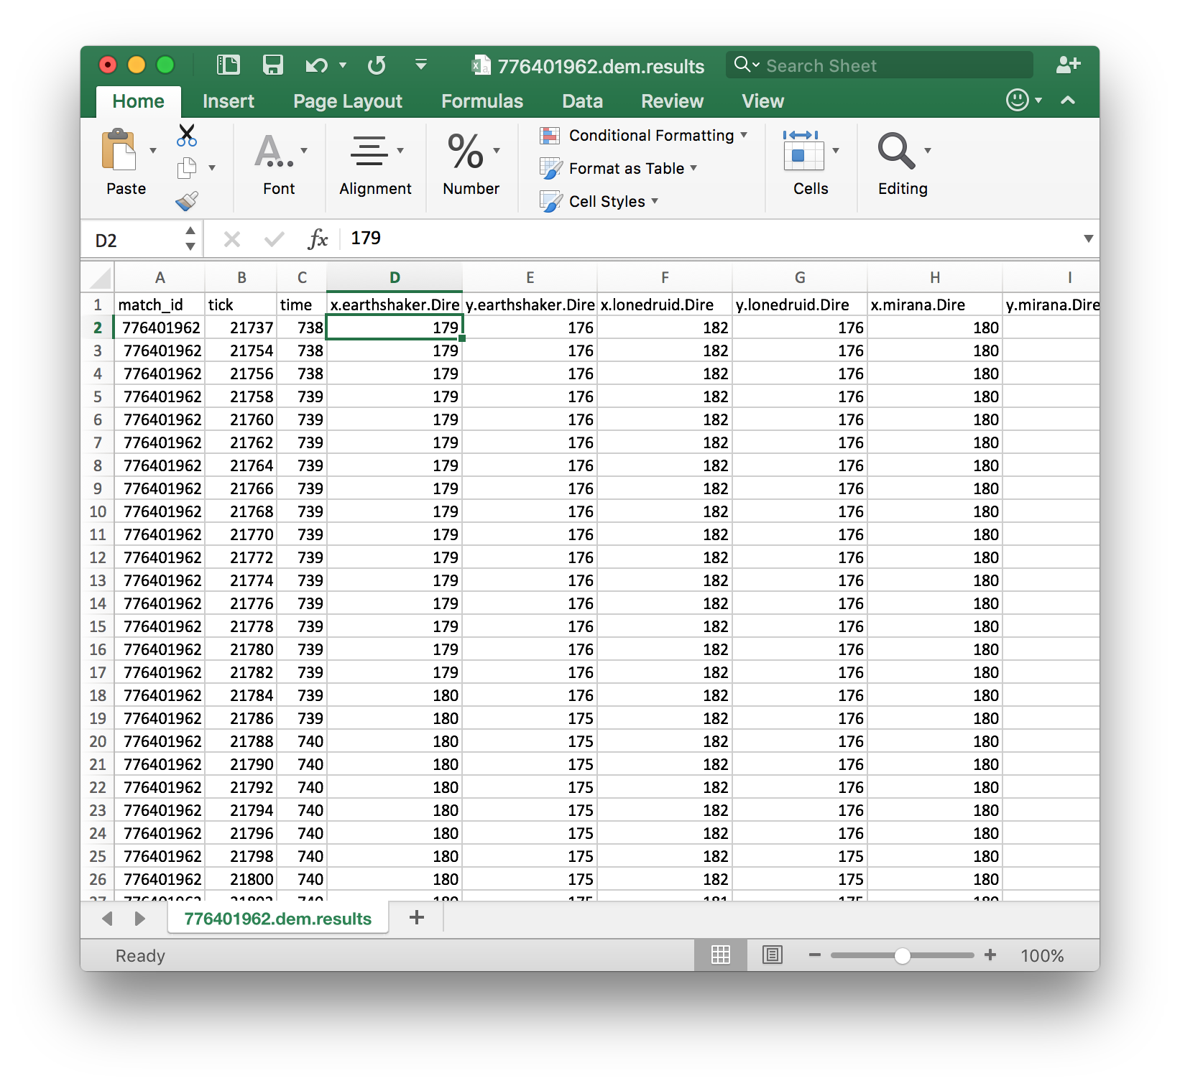
Raw DOTA Data Processing
Java parser*
R script
R script
Symbol sequence
Raw
games
json
Zipped csv
*Written by Ellen Badgley

Slide 11
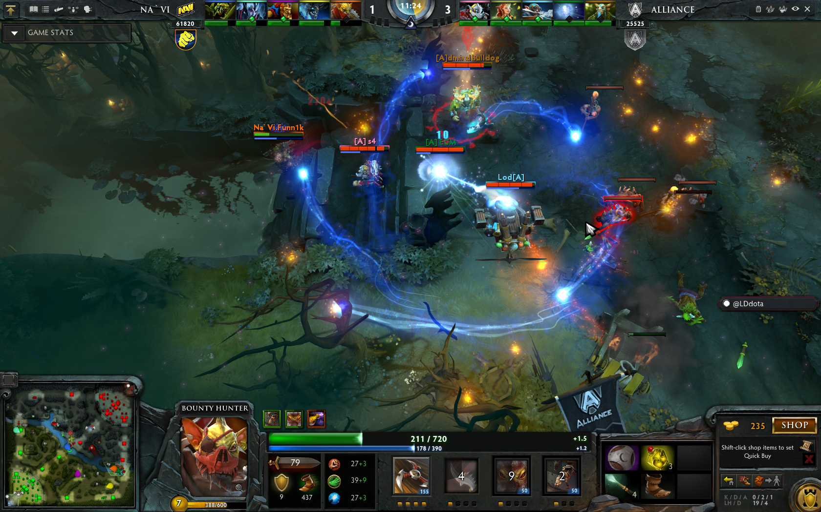
DOTA Observables
Parsed
Non-Parsed (examples)
Position x, y
Kills
Heroes
Towers
Others
Damage taken
Heroes
Others
Damage dealt
Heroes
Others
Gold
XP
Deaths
Item purchases
Item uses
Leveling up abilities
Ability uses
Attack modifiers
Healing

Slide 12
Hidden Markov Model Example: Teen Life
Eat
0.1
Study
Hidden states
Assume system has a set of observables (symbols)
Map observables onto system ‘states’ (e.g., A, B)
Using the evolution of states, determine if there is any underlying, hidden structure (AABAAAABCA)
p_{o}=0.2
p_{g}=0.8
p_{s}=1.0
1.0
Prob of emitting symbol
0.2
0.1
0.7
0.2
Talk on phone
Sleep
Hang out
0.3
p_{o}=0.5
p_{z}=0.5
0.2
p_{o}=0.2
p_{b}=0.6
p_{g}=0.2
p_{o}=0.3
p_{s}=0.2
p_{b}=0.4
p_{g}=0.1
0.8
0.1
0.2
0.4
0.7
Transition Matrix
Probability of Symbol Emission
 | Eat | Hang | Study | Talk | Sleep
Eat | 0 | 0.7 | 0.1 | 0 | 0.2
Hang | 0.2 | 0.4 | 0 | 0.2 | 0.2
Study | 0 | 1.0 | 0 | 0 | 0
Talk | 0 | 0.3 | 0 | 0.7 | 0
Sleep | 0.1 | 0.1 | 0 | 0 | 0.8
Symbol | Observable | Eat | Hang | Study | Talk | Sleep
o | [silence] | 0.2 | 0.2 | 0 | 0.3 | 0.5
s | “I’m studying!” | 0 | 0 | 1.0 | 0.2 | 0
b | “I’m busy!” | 0 | 0.6 | 0 | 0.4 | 0
g | [grunt] | 0.8 | 0.2 | 0 | 0.1 | 0
z | [snore] | 0 | 0 | 0 | 0 | 0.5
Adapted from Numerical Recipes: The Art of Scientific Computing (3rd Edition)

Slide 13
Examples of Time Series Observables
Use time-series data to map observables onto “states”

Slide 14
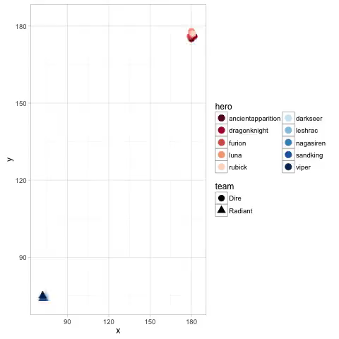
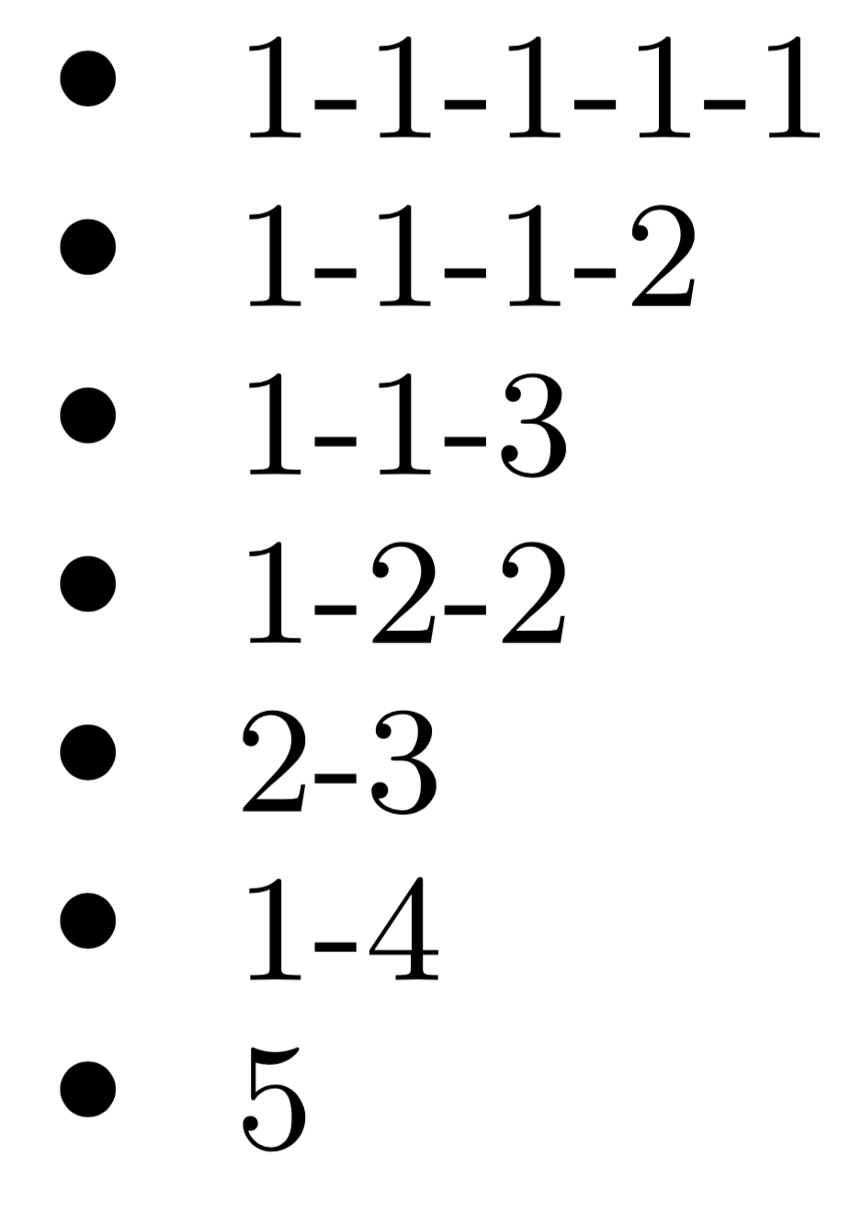
Relative Player Positions: Most Relevant Observable
“1-1-1-1-1”
“5”
1) Deterministic States
2) Clustered States
Kmeans
(GMM)
Notes:
Distances are

Slide 15
Comparing Team Strategies within Games
Characterize “distance” between sequence of states
Team 1: AAAAABBAAACAA
Team 2: AAAABABAACCCD
How many transformations necessary to turn one sequence into other?
Substitutions, insertions, deletions of states
Max distance*: length of sequence
More alike
More different
*Given constant substitution matrix and insertion/deletion cost of 1

Slide 16
Clustering Distance States for ~ 50 Games
0.6
0.4
0.2
0.0
Explained Variance: Inter-cluster Distance / Total Variance
0
25
50
Number of Clusters
Renormalized Y
Method:
Aggregate over 60 s
Renormalize
Concatenate games
Order players by win & gold
Cluster on time series
Renormalized X

Slide 17
Observables and Hidden States: Markov Model*
State
Sequence Step
*HMM code courtesy of Simon DeDeo: http://tuvalu.santafe.edu/~simon/styled-8/

Slide 18
Correlations
Average module
Mostly binary distribution (e.g., 1 or 2)
Correlations: flat
No apparent dependence on aggregate variables

Slide 19
Future Work
Within games:
Gaussian mixture model to determine states
Analyze structure of the HMMs
Fold in additional observables to state structure
Draft:
Analyze how hero composition affects win-rates
Finding an optimal strategy is very difficult
Coarse graining over state space and apply HMM to determine underlying strategies
Between games:
Characterize what strategy players use when switching teams
Exploration of (potential non-linear) time series analysis

Slide 20

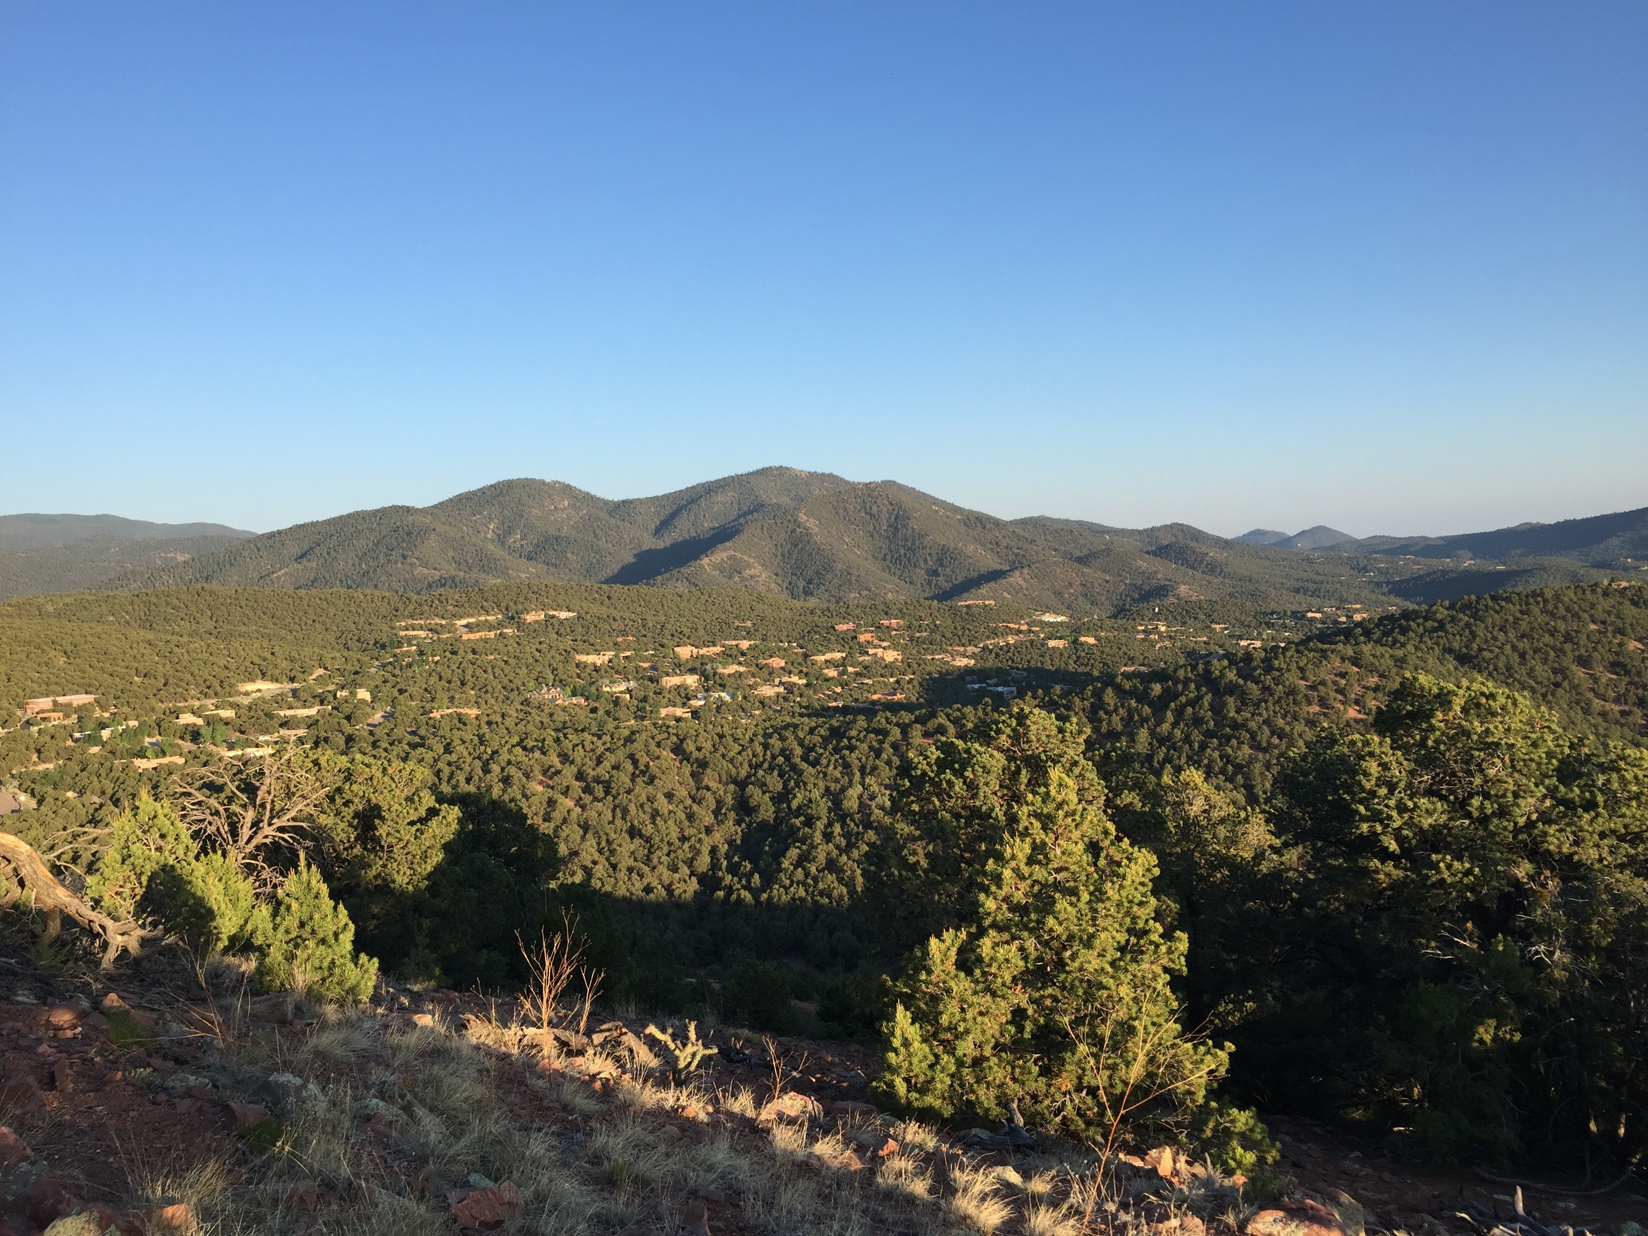

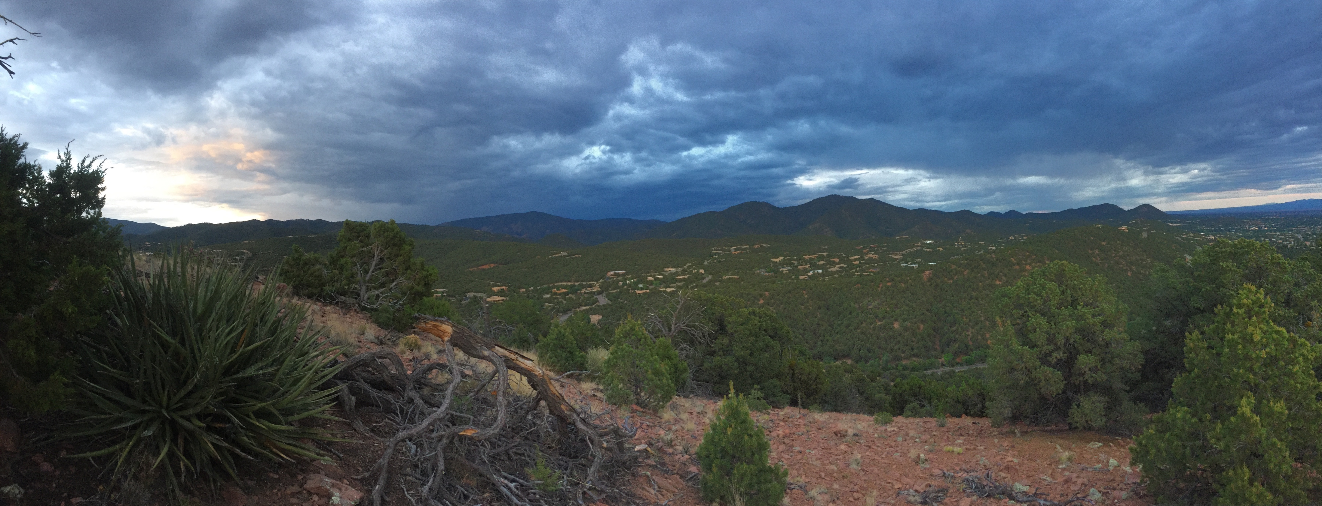
Acknowledgments
MITRE
Sanith Wijesinghe
David Slater
Ellen Badgley
Matt Koehler
Shaun Michel
Tom Young
Chuck Lewis
SFI/CSSS
Simon DeDeo
Marla Stuart
Dan Biro
Salva Duran
JP Gonzalez
Marilia Gaiarsa
THANK YOU!!

Slide 21
Extra Slides

Slide 22
Hidden Markov Model
Overview
Assume system has a set of observables (symbols)
Map observables onto system “states” (e.g., A, B, C)
Using the evolution of states, determine if there is any underlying, hidden structure (e.g., AABAAAABCA)
Mechanics
Assume a number of hidden states:
Determine transition matrix for hidden states, derived from observed rates
Determine probability of each hidden state emitting all observed symbols
Iterate over range of hidden states to calculate optimum number
Maximizes likelihood of model (AIC)
Eigenvalue decomposition of transition matrix reveals underlying macrostructure {λ₁ = 1 (stationary state) > λ₂ [perturbation with longest decay time] > λ₃ ….}

Slide 23
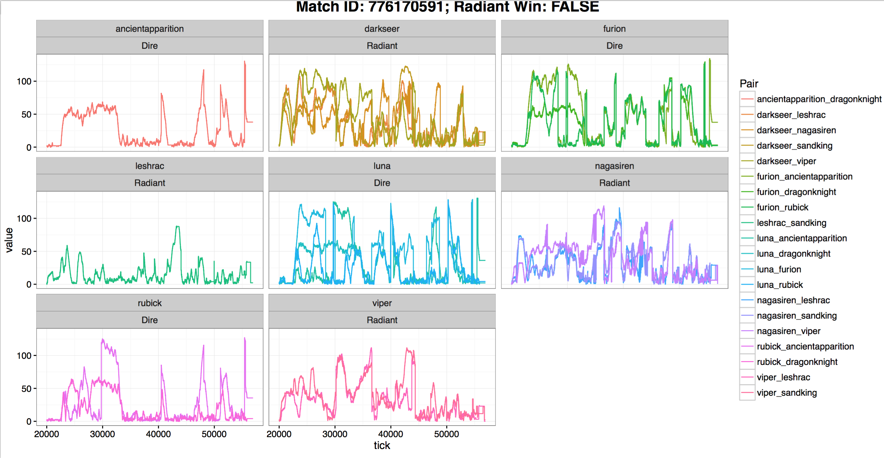
Relative Distances

Slide 24
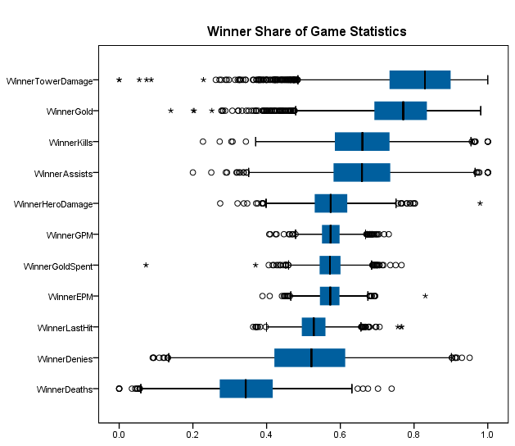
Between Games Statistics
795 Professional Teams
1,295 Players
3,594 Time Sequenced Games
Lots of Game Data
Tower Damage
Gold
Kills
Assists
Hero Damage
Gold Spent
Gold PM
Experience PM
Last Hit
Denies
Deaths

Slide 25
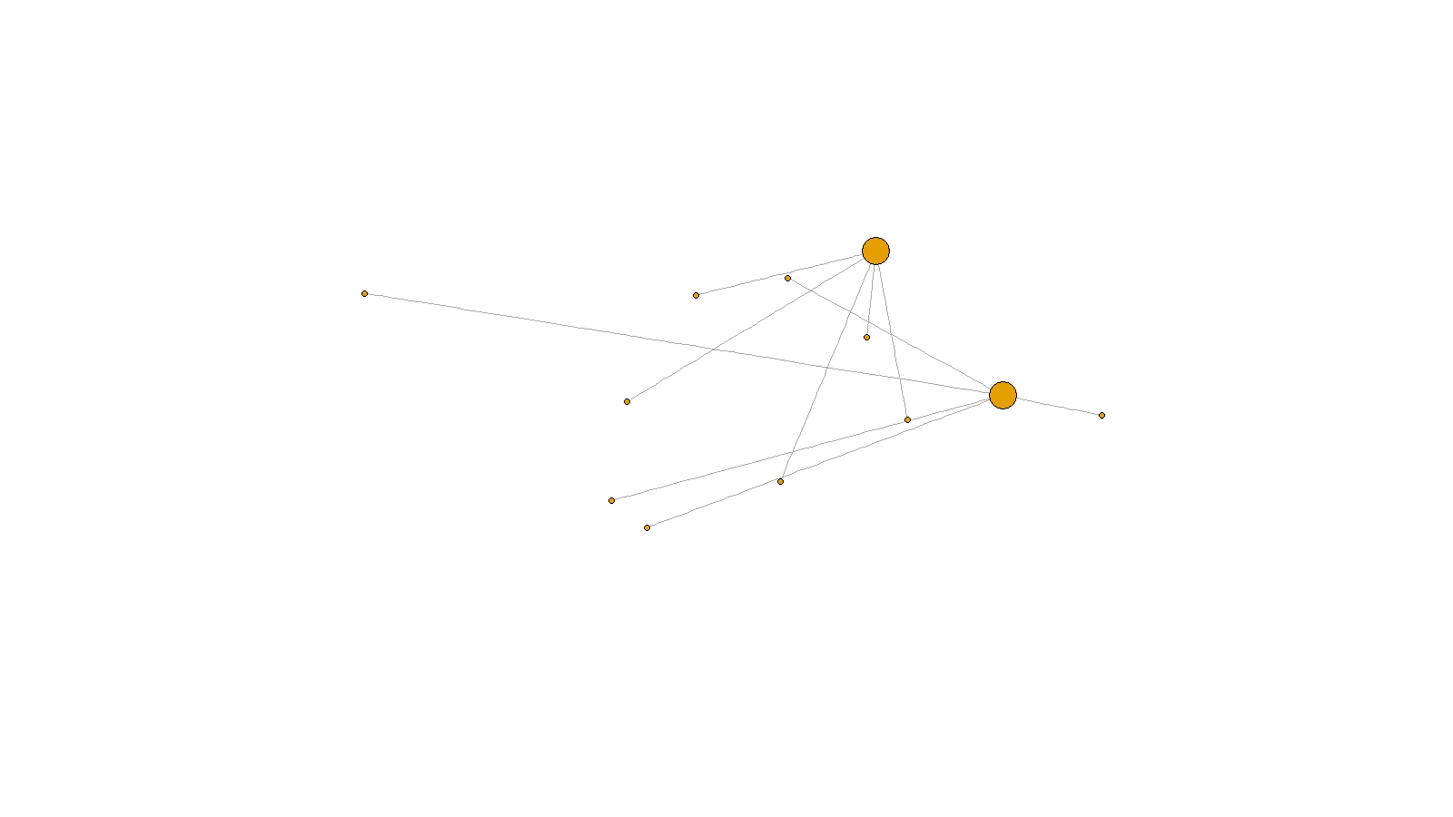
Animated Times Series of Team Formation
Notes:
This section: between games
First: Animated times series of the teams that play the games
Teams – players
Looks like combinatorial evolution (Brian Arthur)
We learned – players change teams
We wanted to look for signals of strategies used by players when they decide to change teams

Slide 26
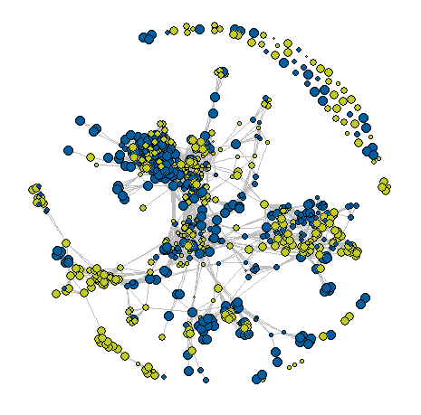
Bipartite Network Teams | Players
| 26 |
Nodes = 795 Teams
Edges = 1,295 Players
3,594 Games
Winning | Losing Average
Node Size = Games Played
Real world
complex systems
6 statistical properties
Guillaume, J. L., & Latapy, M. (2006)
✓ Bipartite structure
✓ Continually growing
✓ Very low density
✓ Low average distance
✓ High clustering
☒ Degrees power law
☒ Preferential attachment
© 2014 The MITRE Corporation. All rights reserved.
Notes:
Is DOTA, over time, a complex system
Empirical question Bipartite network
Look at it – automated graph
See lots of team changing
Real world complex systems – 6 properties
Use these to determine if DOTA is complex
Marillia

Slide 27
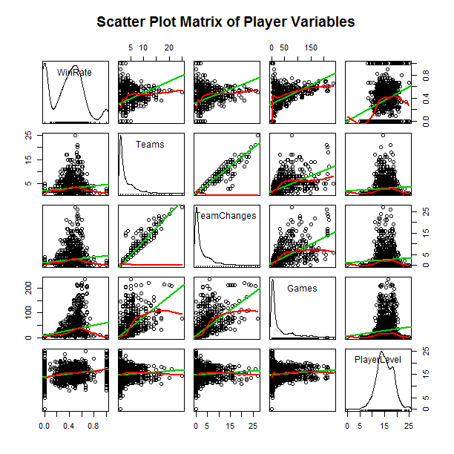
Why do players change teams?
No Signal!
Game duration
Game Statistics from previous slide
Positive/Negative Votes
First Blood Time
League
Notes:
We don’t now
No signal from game data
Interesting player data
Medians

Slide 28
Selecting Cluster Numbers
x, y
Gold
XP
Deaths
Kills of heroes
Kills of towers
Kills of others
Damage taken from heroes
Damage taken from others
Damage dealt to heroes
Damage dealt to others

